Slide 1
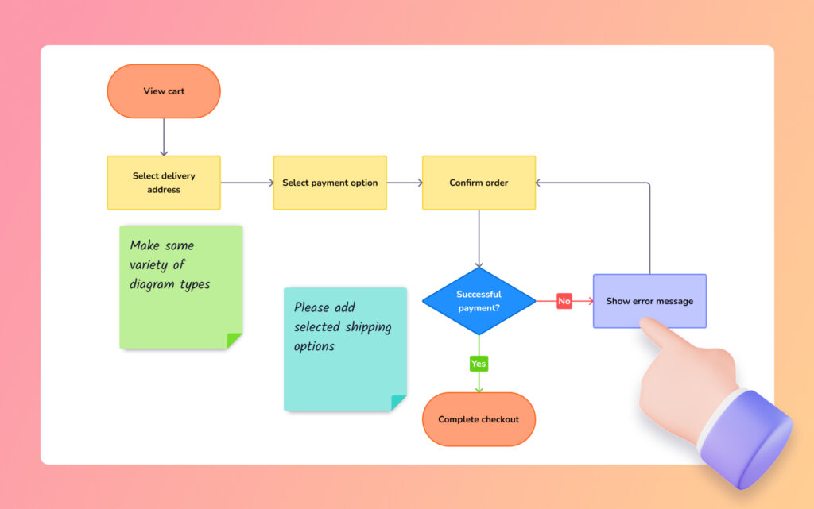
Chapter Six :
Decisions and Conditions
1008_Introduction to Programming
Compiled by Ms. Dianne Sikinapi & Ms. Odilia Tita

Slide 2
Learning Objectives
By the end of this Unit, students should be able to:
  Use blocks ‘If’s’ to control the flow of logic.
  Understand and use the nested ‘If’s’.
  Create Flowcharts indicating the logic in a selection process.
  Evaluate conditions using the Relational Operators.
  Combine conditions using AND and OR.
  See Textbook - Introduction to Programming Book 2 Pages 152- 183

Slide 3
6.1 Decision Making in Programming
There might come a time where we need to instruct the computer to make decisions based on the input. This process of instructing computers to make decisions is known as ‘decision making’ in programming.
A powerful asset of the computer is its ability to make decision and to take alternate course of action based on the outcome.
A decision made by the computer is formed as a question: Is a given condition true or false? If it is true, do one thing; if it is false, do something else.

Slide 4
a.) ‘if’ and ‘else’ statements
In programming, the ‘if’ and ‘else’ statements check whether a condition is true or false. If the condition is true, it executes some particular set of codes and if the condition is false, it executes some other set of codes.
Example:
  If the sun is shinning Then (condition)
  Go to the beach (Action to take if the condition is true)
  Else
  Stay home (Action to take is the condition is false)
  End if
In the example, in ‘if’ statement, when the condition is true, only the Then clause is executed. When the condition is false, only the Else clause is executed.

Slide 5
b.) ‘if’, ‘else-if’ and ‘else’ statements
What if we needed to check for more conditions? We can chain the ‘if‘ and ‘else’ statements using the extra ‘else if’ statement.
Example:
  If Number is > 0 Then (condition)
  Print ‘Number is positive’
  else if Number is < 0
  Print ‘Number is negative’
  else
  Print ‘Number is 0’

Slide 6
The if and else statements are used to make decisions in programming.
The if statement checks for a single condition and performs a single operation, while the else statement checks for a single condition and performs two or multiple operations.
For the if statement, if the condition is true, then the statements in the if block gets executed. If the condition is false, then the statements in the if block are ignored.
For the else statement, if the condition is true, then the statements inside the else block are ignored. If the condition is false, then the statements inside the else block gets executed.

Slide 7
6.2 The Relational (Comparison) Operation
The test in an ‘if’ statement is based on condition. To form condition, six relational operators are used to compare values. The result of the comparison is either True or False.
Relational Operators from Relational Operation are used to compare two values with each other.
Relational operators take two operands, compare their values, and return a Boolean value (true or false). They are typically used in conditional expressions to test whether a condition is true, or not.
Table showing the common relational operators
Symbol | Description | Symbol | Description | Symbol | Description
> | Greater Than | = | Equal to | > = | Greater than or equal to
< | Less Than | < > | Not equal to | < = | Less than or equal to

Slide 8
Sample Example of Comparison
Given these:
intAlpha = 5, intBravo = 4, intCharlie = -5
Condition | Evaluates
intAlpha = intBravo | False
intCharlie < 0 | True
intBravo > intAlpha | False
intCharlie < = intBravo | True
intAlpha > = 5 | True
intAlpha < > intCharlie | True

Slide 9
The Relational Operators are also called Comparison Operators because they are used to compare values.
Relational Operators can be used to compare the following values:
  Comparing variables and constants
  Comparing strings
  Testing for True or False
  Comparing the Text Property of textboxes
  Comparing uppercase and lowercase letters.

Slide 10
6.3 The Logical Operation (Compound Conditions)
In programming, you can use compound condition to test more than one condition.
The term 'compound conditions' refers to any situation where the condition needs more than one answer to return true. An example would be checkbox items checking two or more answers.
We can create compound conditions (more than one condition) in programming by joining conditions with logical operators.
Logical operators are generally used for combining two or more relational statements. They return Boolean values (true or false).
There are three types of Logical Operators which are:
  Or ( || )
  And ( && )
  Not ( ! )

Slide 11
Sample Example of Logical Operators
Given these:
lblNumber.Caption > = 1, txtNumber.Text < 11, txtNumber.Text > 0
Logical Operator | Meaning | Example | Result
Or (||) | If one condition or both conditions are true, the entire condition is true | lblNumber.Caption = 1 Or lblNumber.Caption = 2 | True
And (&&) | Both condition must be true for the entire condition to be true | txtNumber.Text > 0 And txtNumber.Text < 10 | True
Not (!) | Reverse the condition so that true condition will evaluate false and vise versa | Not lblNumber.Caption = 0 | True

Slide 12
The Compound Conditions can also be referred to as Logical Operation because they are used to compare values of more than one condition, unlike Relational operators, as they deal with only one condition.
One can use the Logical Operators to:
  Test the value of a Textbox
  Test the value of an Option Button
  Checking the value of an Option Button group
  Checking the values of multiple Check Boxes
  Selecting cases

Slide 13
Summary
Read Chapter Summary Notes on Page 181 of Introduction to Programming Book 2.
Review Exercises
Complete all 9 review questions on Page 182 of Introduction to Programming Book 2.
Try to at least do Hands-On Programming Examples and Exercises

